Slide 1
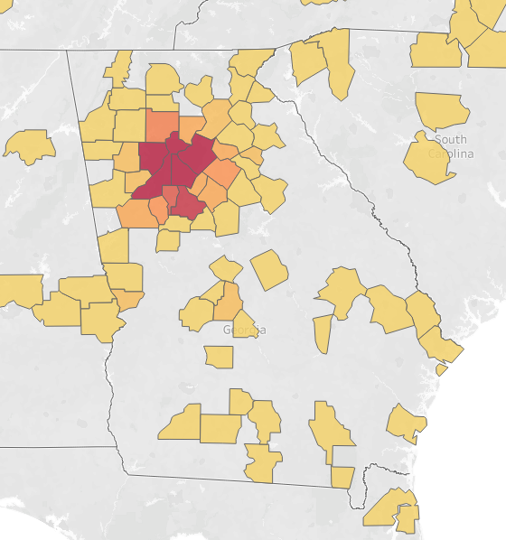
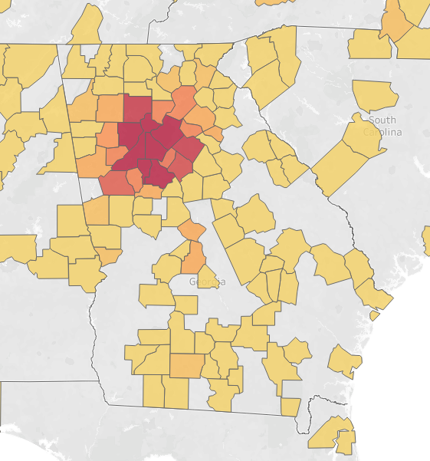
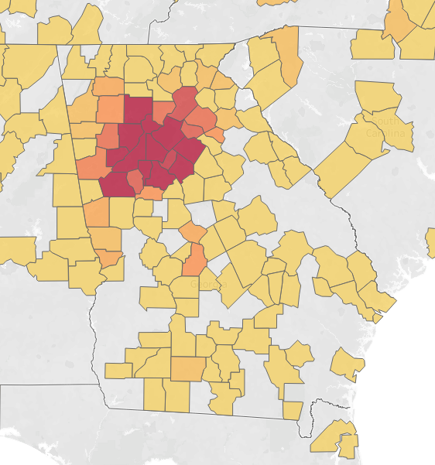
Statewide Reach of Pediatrics Research Supported by the Georgia CTSA
Nicole Llewellyn, PhD¹, Amber Weber, MPH¹, Anne Fitzpatrick, PhD, RN, CPNP, MSCR^{1,2}, & Eric Nehl, PhD¹
¹Emory University, ²Children’s Healthcare of Atlanta
Introduction
Results: pediatric Research Participants Across Georgia
The Pediatrics Program of the Georgia Clinical and Translational Science Alliance (Georgia CTSA) is a longstanding effort to transform scientific discovery into solutions that improve pediatric health across Georgia, by ensuring that research projects have the resources needed to move forward
It is an important aim of the program to have a statewide scope inclusive of urban, suburban and rural pediatric populations
Therefore, we examined the statewide scope of supported research by mapping research participants’ hometowns across Georgia, contextualizing findings across time, research discipline, and urbanicity
The Georgia CTSA supported:
175 Pediatric research studies
Approximately 5,000 participants
Hailing from:
5 countries
38 states
349 Georgia zip codes
Figure 1. Cumulative growth in geographic distribution and density of pediatric research participants over time
Since 2007, representation has expanded gradually across the state
As of 2020, 78% of participants came from the urban Atlanta area, but two thirds of GA counties are thus far represented
Table 1. Research Participants Across GA & Research Areas
Research areas with >250 participants | Total # Participants | From # Counties | Percentage from urban Atlanta metro counties (Dekalb, Fulton, Gwinnett, Cobb, & Clayton)
Infectious Diseases | 2293 | 80 | 84%
Influenza | 548
RSV | 436
Pneumonia | 199
Rotavirus | 198
Pulmonology | 817 | 51 | 79%
Asthma | 544
Cystic Fibrosis | 171
Psychiatry | 437 | 26 | 86%
Depression | 170
PTSD | 162
Nephrology | 395 | 139 | 32%
Polycystic Kidney Disease | 329
Endocrinology | 390 | 58 | 66%
Diabetes | 312
Figure 2. Notable variability in statewide reach and urbanicity across the top 5 research areas:
Although Psychiatry and Nephrology included similar numbers of participants, Psychiatry participants came from few, largely urban Atlanta counties, whereas Nephrology participants came from many, largely non-urban counties
Data collection
In 2020, we collected participant data for all pediatric studies supported by the Georgia CTSA Clinical Research Centers (GCRCs)
Using Tableau, we conducted geospatial analyses of statewide representation, mapping participant zip codes over time, including density and urbanicity across Georgia
Urban Metro Atlanta: defined as the 5 counties adjacent to the Interstate-285 perimeter: Clayton, Cobb, Dekalb, Fulton, & Gwinnett
Finally, we individually mapped and compared patterns for the 5 most frequently represented research areas
Conclusion & Future Directions
Contact
Geospatial mapping of participants informs our understanding of the statewide scope & diversity of pediatric research supported by the Georgia CTSA
Although the GCRCs are centrally located in Atlanta, participants came from hometowns at significant distances in suburban/rural Georgia, with the geographic spread increasing over time and varying by research area
Findings can be used to gauge areas of strength in statewide inclusion as well as geographic segments that may stand currently untapped
Contact: Nicole.llewellyn@emory.edu

